Slide 1

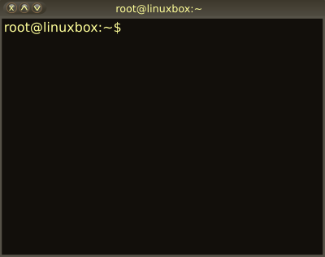

05 – Basic Unix System Administration
COMP 190 – Dickinson College
Fall 2021
Images from: openclipart.org

Slide 2
System Administration
VirtualBox Snapshots
The Super User
Users and Groups
Software Installation
Package Managers
Graphical Interface
Command Line Interface

Slide 3
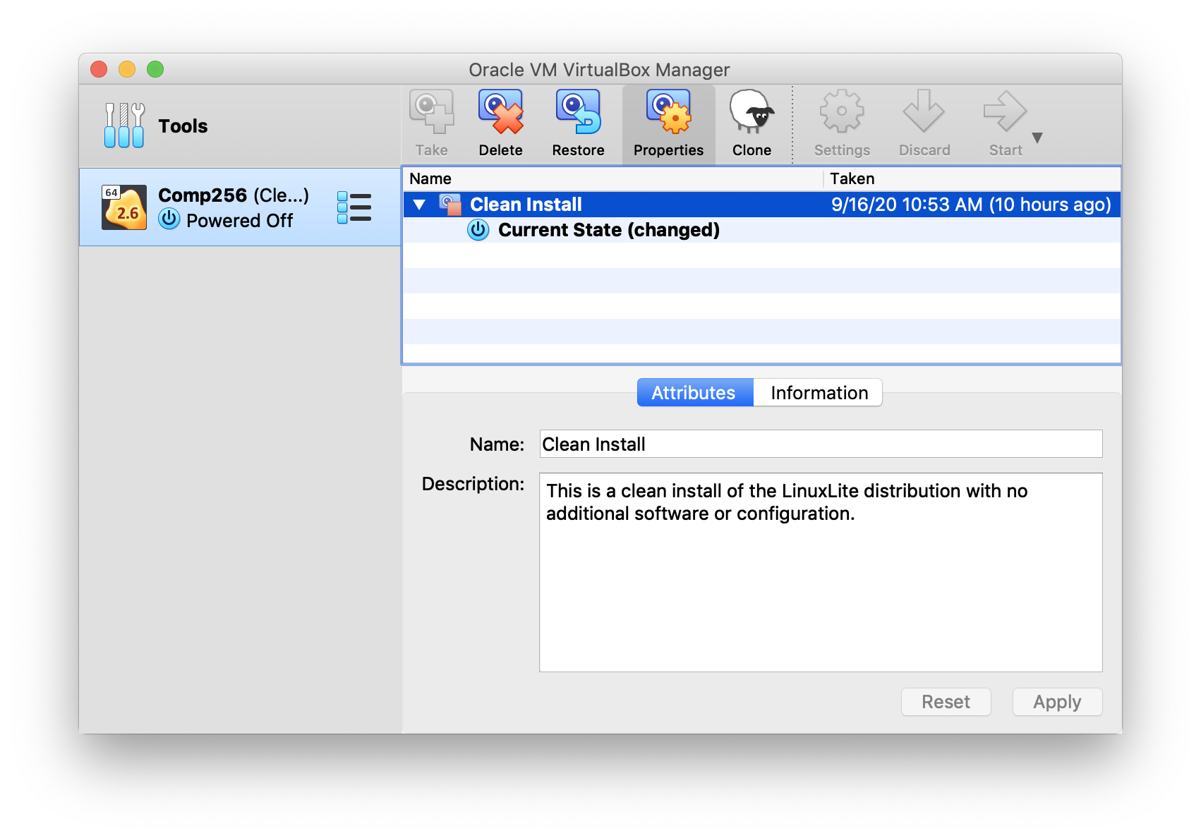
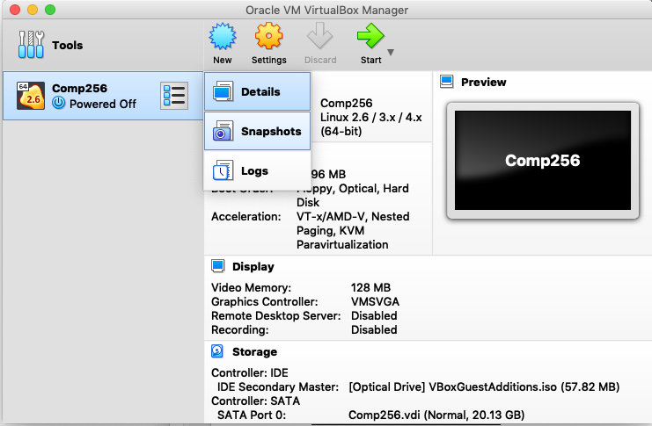
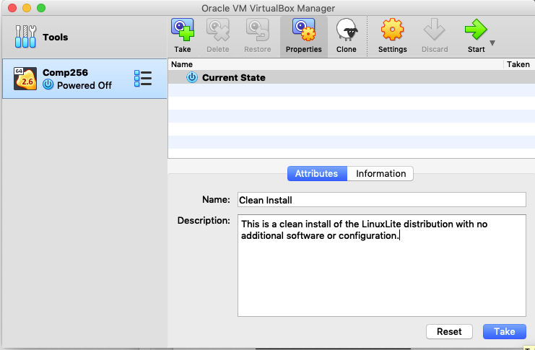
VirtualBox Snapshots
A snapshot is a backup of your virtual machine that will allow you to restore it to a known (hopefully functional) state.
Notes:
Each snapshot takes up some space on your host disk drive.
So keeping lots and lots of snapshots can take up a lot of space.
Often will be good to delete old snapshots that you don’t need any more.
- i.e. take some as you move through a process at key points
- but then delete all but the last one
- Or take one at the start, then mess around until you know how to do what you want to do correctly.
- then do it from the snapshot
- then take another one and maybe delete the first one.
Great for when you mess stuff up!!!

Slide 4
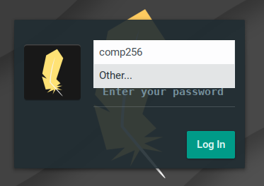
root user and sudo
Unix is a multi-user system
root is the name of the super user
cannot log in - security
sudo runs commands as the super user
User must have admin (adm group) privileges
E.g. sudo apt install apache2
Notes:
The first user created during install is automatically added to the admin (adm) group.
If you were setting up a machine for multiple people to use (e.g. in a lab)
Then your user would be in the adm group
But the users you create for others would not be in the adm group
They might be in a users, staff or student group,
Which could then be assigned different privileges
Example, installing software on the machine requires admin privileges.

Slide 5
Software Installation
A package manager is a tool to simplify installing software and managing its external dependencies.
System-Level Package Managers
apt, rpm, yum, pacman, brew, snap
Project-Level Package Managers
JavaScript npm
Python pip conda
Java maven gradle
Notes:
Apt – advancd packaging tool
Rpm – redhat package manager
Yum – yellowdog updater – modified
Pacman – archlinux
Brew – macOS
Snap – linux
For now we’ll focus on system software package manager
We will use APT the Synaptic Package Manager
It is a really good one and is what is the default on Ubuntu, Debian, LinuxLite
Maybe later we’ll look at one for a specific project…

Slide 6
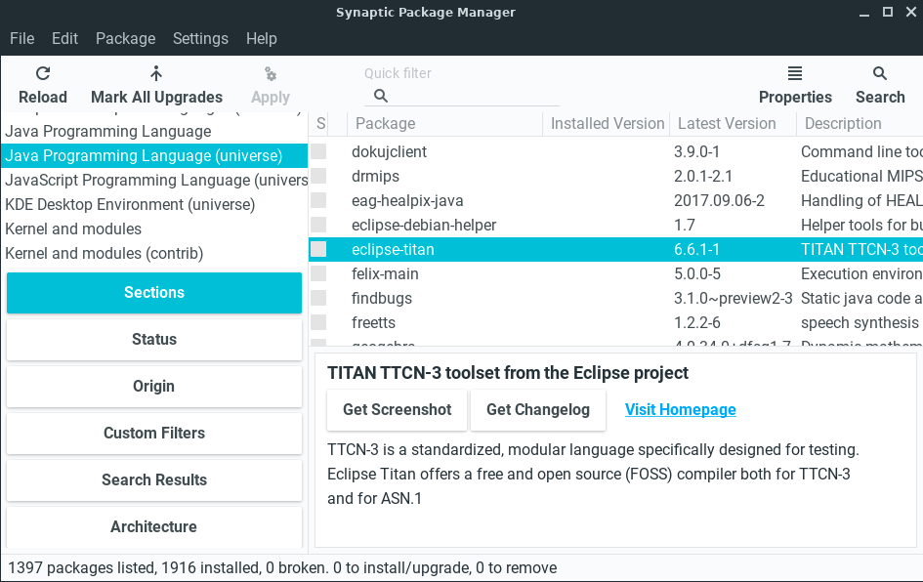
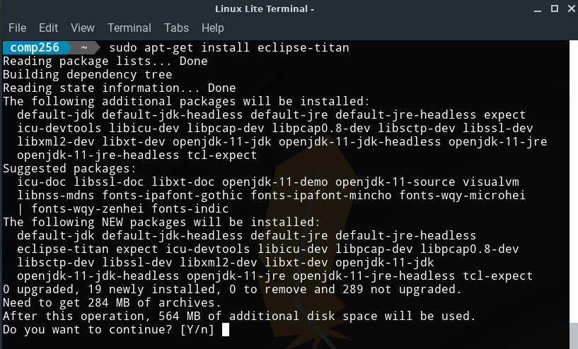
apt & Synaptic Package Manager
Notes:
Like CLI and GUI File manager …
APT and Synaptic are different interfaces to the same thing
APT is a command line tool
Synaptic Package Manger is a GUI too.

Slide 7
What’s Next?
A05 / Q05 – Due 1 week
Revise and Resubmits (A01– A04)
Prepare for Reading and Discussion

Slide 8

Acknowledgments:
Slide Template From:
https://creativecommons.org/licenses/by/4.0/
Slide Content Licensed as:
https://creativecommons.org/licenses/by-nc/4.0/

